Slide 2
Course Overview
Day 1: Introduction to ML, Model Building, Text Processing, Bag of Words (BoW), and K Nearest Neighbors Model (KNN)
Day 2: Tree-based Models, Regression Models, Optimization, Regularization, Hyperparameter Tuning, and AWS AI/ML Services
Day 3: Neural Networks, Word Embeddings, Recurrent Neural Networks (RNN), and Transformers
Day 4: Tabular Data, AutoGluon, Image Classification, Convolutional Neural Networks (CNN), and Transfer Learning

Slide 3
Topics for Day 3
Neural Networks (NN)
Word Embeddings
Recurrent Neural Networks (RNN)
Long Short-Term Memory (LSTM)
Transformers
Final Project

Slide 4
Topics for Day 3
Neural Networks (NN)
Word Embeddings
Recurrent Neural Networks (RNN)
Long Short-Term Memory (LSTM)
Transformers
Final Project

Slide 5
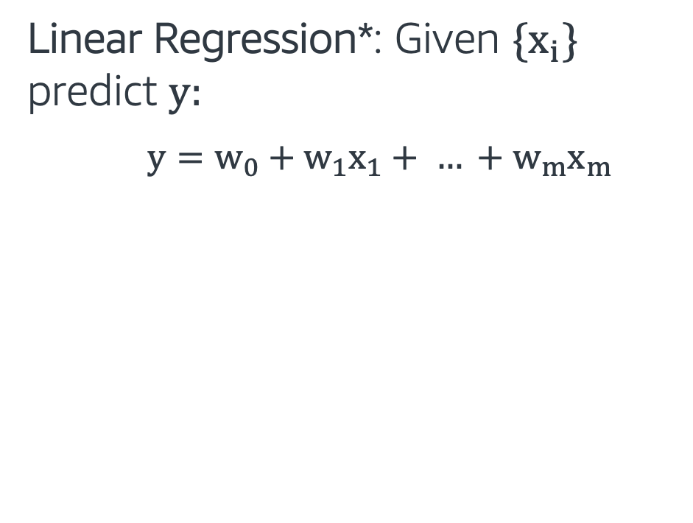
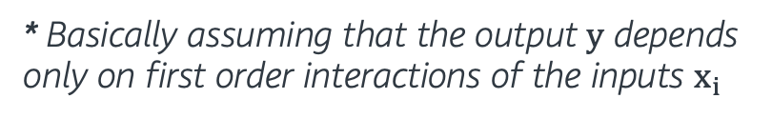

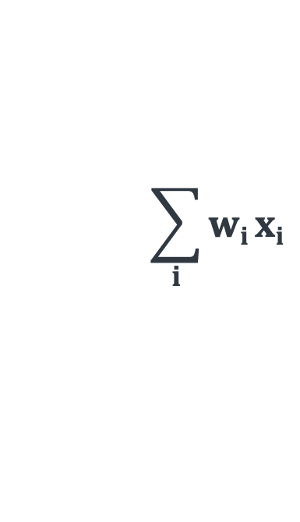
Looking back at Regression Models
Linear Regression*: Given {$x_{i}$} predict $y$:
$y=w_{0}+w_{1}x_{1}+ … +w_{m}x_{m}$
w₀
w₁ x₁
x₁
$$\sum_{i}{wi}xi$$
w₂ x₂
$$y$$
x₂
w₃ x₃
x₃
Input
Output
* Basically assuming that the output y depends only on first order interactions of the inputs $x_{i}$

Slide 6
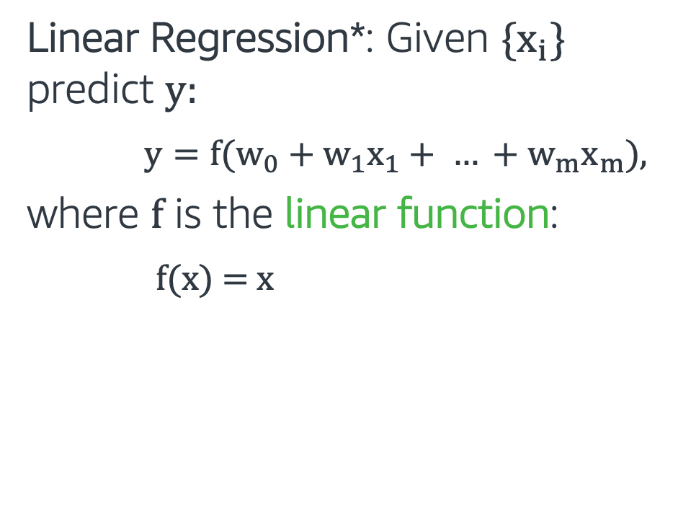
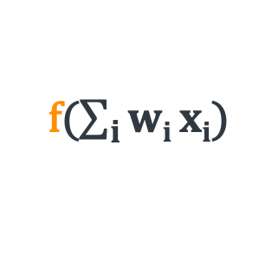
Looking back at Regression Models
Linear Regression*: Given {$x_{i}$} predict $y:$
$y={f(w}_{0}+w_{1}x_{1}+ … +w_{m}x_{m}$),
where f is the linear function:
$f$(x) = x
w₀
w₁ x₁
x₁
$$\sum_{i}{wi}xi$$
f($\sum_{i}{wi}xi$)
w₂ x₂
f
$$y$$
x₂
w₃ x₃
x₃
Input
Activation
function
Output
* Basically assuming that the output y depends only on first order interactions of the inputs $x_{i}$

Slide 7
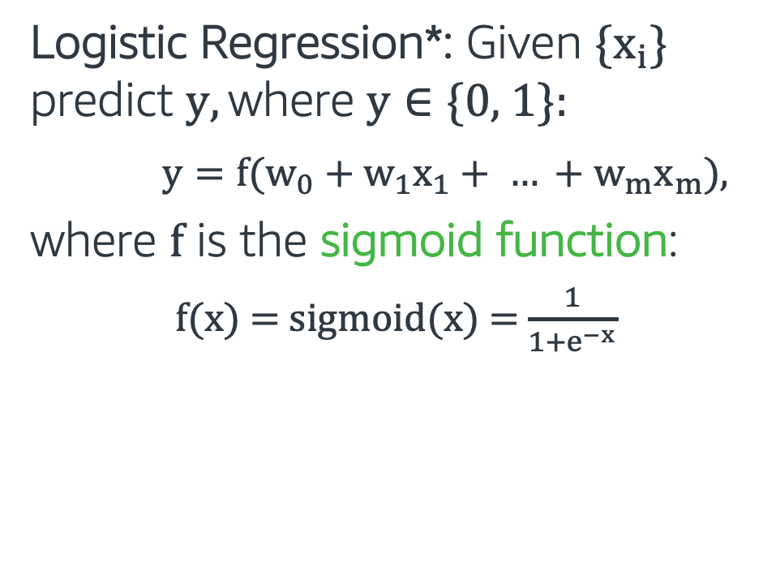
Looking back at Regression Models
Logistic Regression*: Given {$x_{i}$} predict $y, \text{where} \text{y}∈\text{\{0, 1\}}$:
$y={f(w}_{0}+w_{1}x_{1}+ … +w_{m}x_{m}$),
where f is the sigmoid function:
$f$(x) = $sigmoid$(x) = $\frac{1}{1+e^{−x}}$
w₀
w₁ x₁
x₁
$$\sum_{i}{wi}xi$$
f($\sum_{i}{wi}xi$)
w₂ x₂
f
$$y$$
x₂
w₃ x₃
x₃
Input
Activation
function
Output
* Non-linear activation function

Slide 8
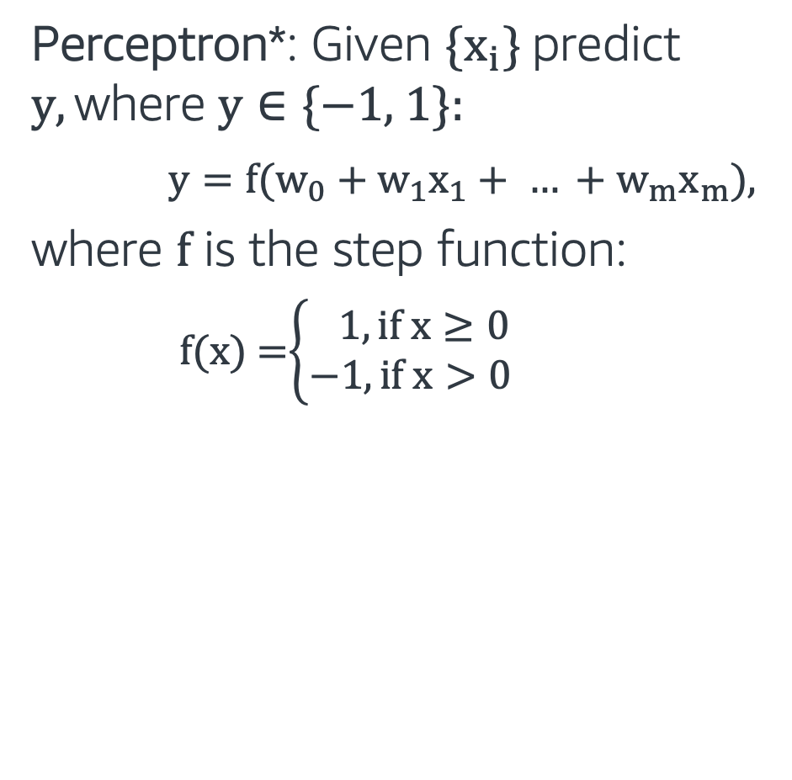
Perceptron
Perceptron*: Given {$x_{i}$} predict $y, \text{where} \text{y}∈\text{\{−1, 1\}}$:
$y={f(w}_{0}+w_{1}x_{1}+ … +w_{m}x_{m}$),
where f is the step function:
$f$(x) =$\left\{\begin{aligned} 1, if x≥0 \\ −1, if x>0\end{aligned}\right.$
w₀
w₁ x₁
x₁
$$\sum_{i}{wi}xi$$
f($\sum_{i}{wi}xi$)
w₂ x₂
f
$$y$$
x₂
w₃ x₃
x₃
Input
Activation
function
Output
* Another non-linear activation function

Slide 9
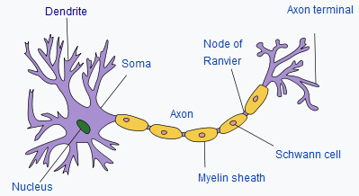
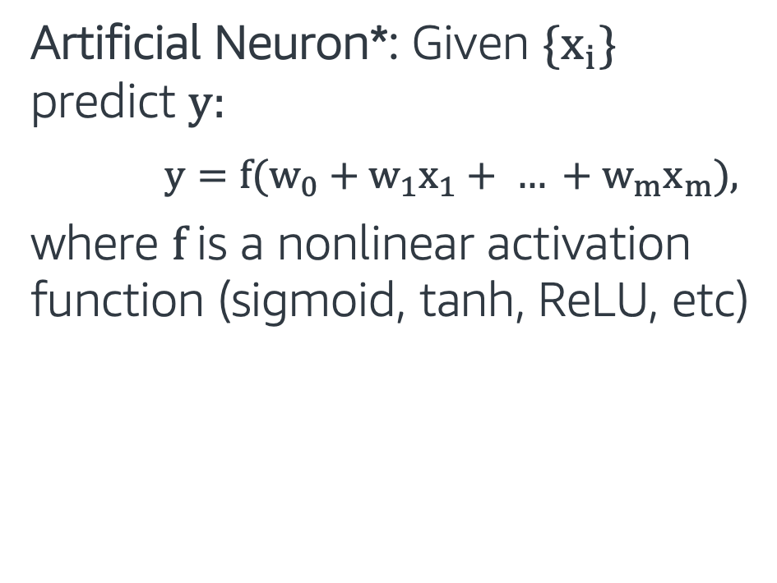
Artificial Neuron
Artificial Neuron*: Given {$x_{i}$} predict $y$:
$y={f(w}_{0}+w_{1}x_{1}+ … +w_{m}x_{m}$),
where f is a nonlinear activation function (sigmoid, tanh, ReLU, etc)
w₀
w₁ x₁
x₁
f($\sum_{i}{wi}xi$)
$$\sum_{i}{wi}xi$$
f($\sum_{i}{wi}xi$)
w₂ x₂
f
$$y$$
x₂
w₃ x₃
x₃
Input
Activation
function
Output
* Similar to how neurons in the brain function

Slide 10
Artificial Neuron
Artificial Neuron: Captures mostly linear interactions in the data
Question: Can we use a similar approach to capture non-linear interactions in the data?
w₀
w₁ x₁
x₁
f($\sum_{i}{wi}xi$)
$$\sum_{i}{wi}xi$$
f($\sum_{i}{wi}xi$)
w₂ x₂
f
$$y$$
x₂
w₃ x₃
x₃
Input
Activation
function
Output

Slide 11
Multi Layer Perceptron
Artificial Neuron: Captures mostly linear interactions in the data
Question: Can we use a similar approach to capture non-linear interactions in the data?
Neural Network/Multilayer Perceptron: Use more Artificial Neurons, stack in layers!
input layer
hidden layer 1
hidden layer 2
output layer

Slide 12
Multi Layer Perceptron
A neural network consisting of input, hidden and output layers.
Each layer is connected to the next layer.
An activation function is applied on each hidden layer
More details
input layer
hidden layer 1
hidden layer 2
output layer

Slide 13
Why Neural Networks?
In the last 5-10 years, neural networks achieved state-of-the art results in many different machine learning areas.
Neural networks can automatically extract useful features from input data. Traditionally feature engineering has been the most laborious and unprincipled part of building ML models
When using neural networks, we should be careful about model complexity and make sure we have enough amount of data for training.

Slide 14
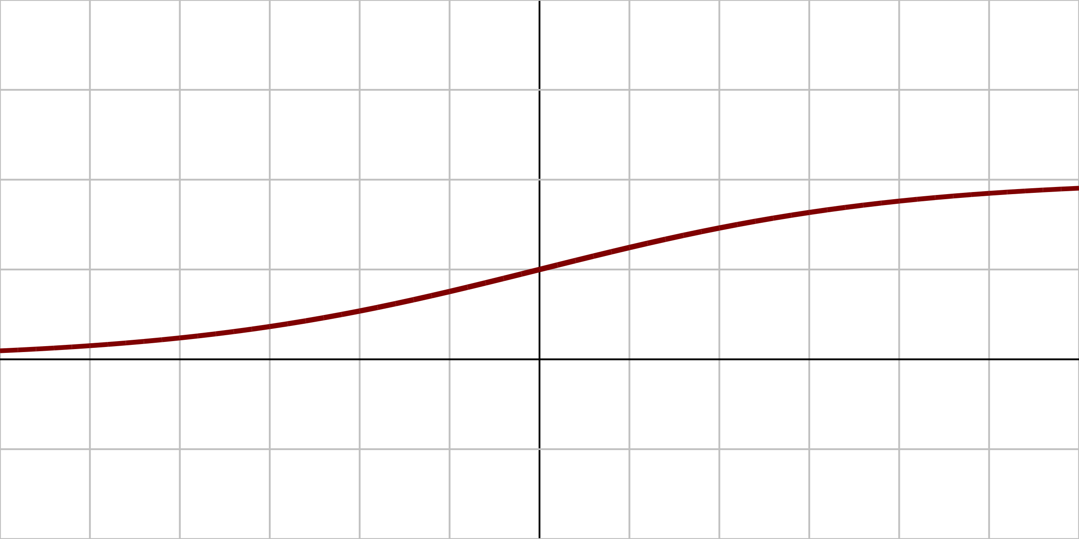
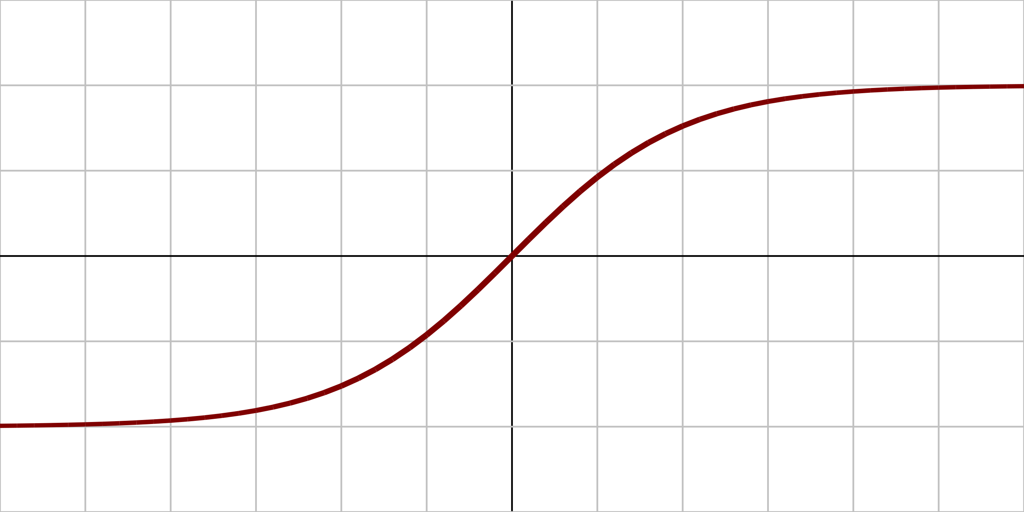
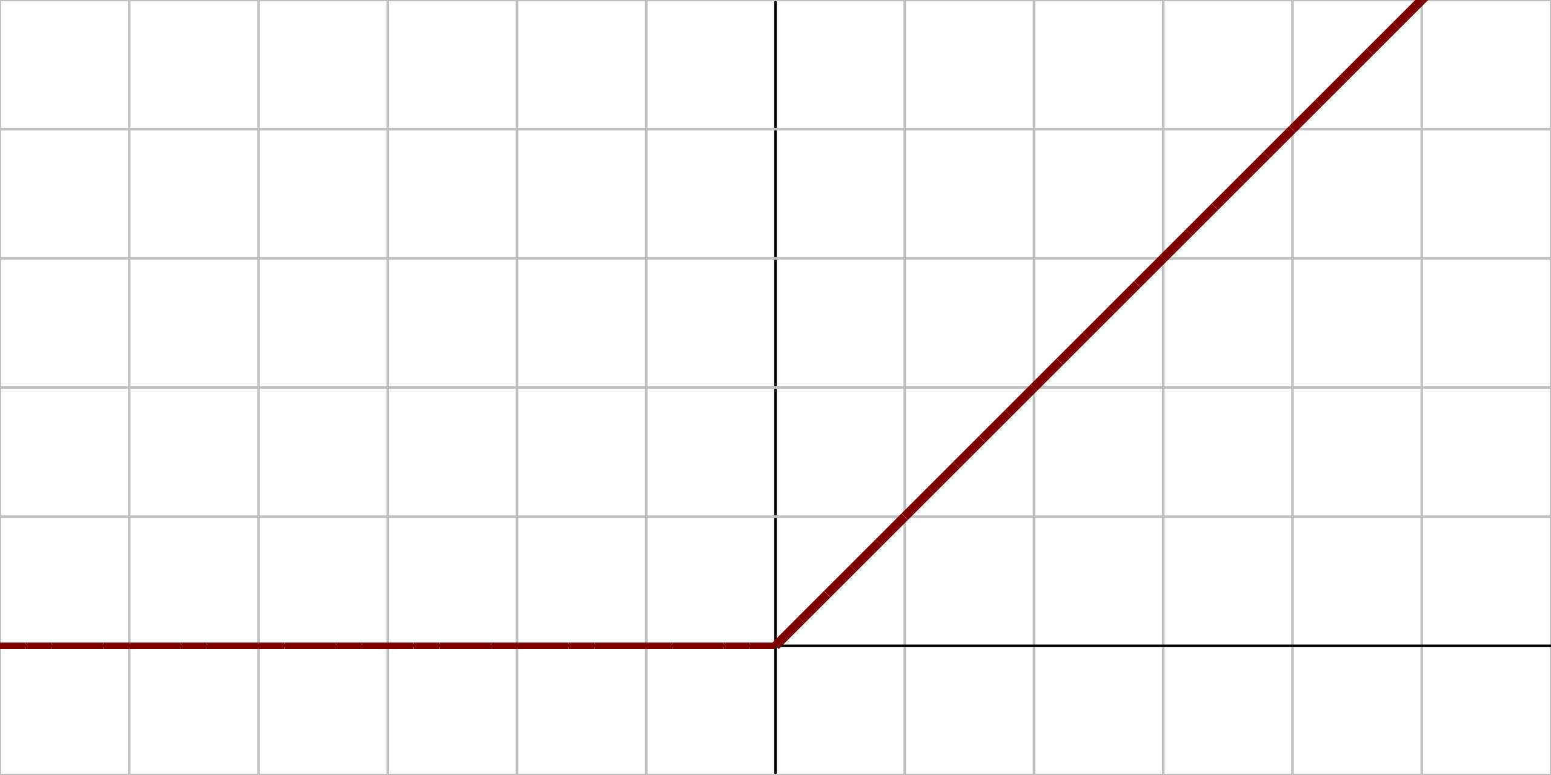
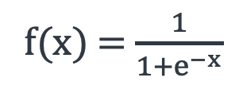
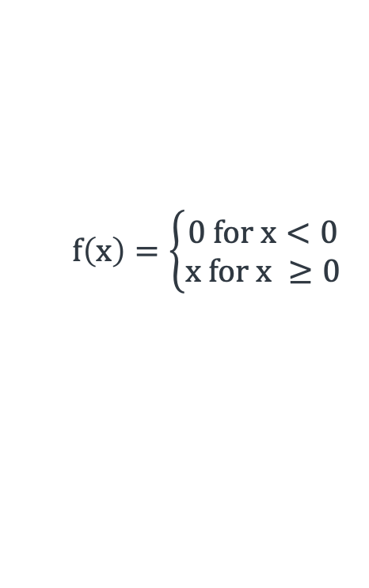
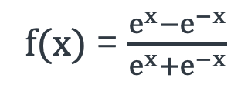
Activation Functions
Derivatives of these functions are also important when we use gradient descent.
Name | Plot | Function | Description
Logistic (sigmoid) |  |  | The most common activation function. Squashes input to (0,1)
Hyperbolic tangent (tanh) |  |  | Squashes input to (-1, 1)
Rectified Linear Unit (ReLU) |  |  | Popular activation function. Anything less than 0, results in zero activation
1
f(x) = $\frac{1}{1+e^{−x}}$
0
x
1
f(x) = $\frac{e^{x}−e^{−x}}{e^{x}+e^{−x}}$
0
x
-1
$$f\left(x\right)=\left\{\begin{aligned}0 for x<0 \\ x for x ≥0\end{aligned}\right.$$
0
x

Slide 15
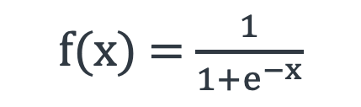
Forward Pass
Assume we have a network with:
2 inputs: i₁ = 0.5 and i₂ = 0.1
1 output (Binary classification: 0 or 1)
1 Hidden layer with 2 neurons
All neurons have sigmoid activation function:
w₁
h_{1_in}
h_{1_out}
i₁
w₅
w₃
w₂
o_{in}
o_{out}
w₄
h_{2_in}
h_{2_out}
i₂
w₆
f(x) = $\frac{1}{1+e^{−x}}$

Slide 16
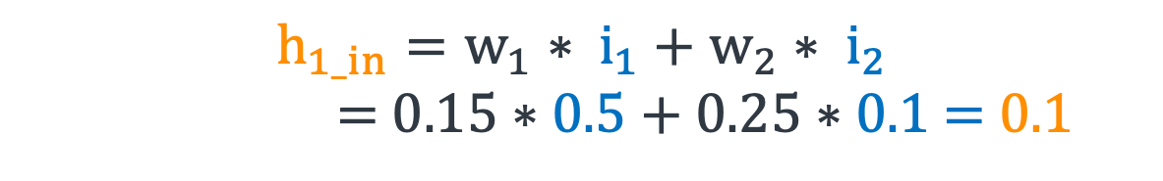
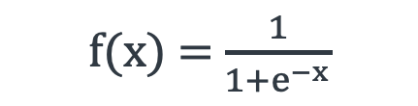
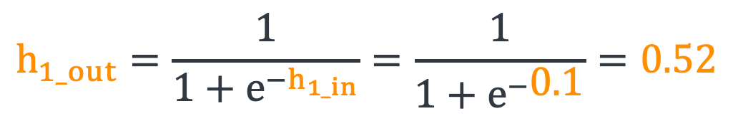
Forward Pass
If w₁ = 0.15, w₂ = 0.25, w₃ = 0.2, w₄ = 0.3, w₅ = 0.4, and w₆ = 0.45:
h_{1_in}
h_{1_out}
$$h_{1_in}=w_{1}∗ i_{1}+w_{2}∗ i_{2}$$
= $0.15∗0.5+0.25∗0.1$ = 0.1
0.5
0.15
0.2
0.4
o_{in}
o_{out}
0.25
0.3
h_{2_in}
h_{2_out}
$$h_{1_out}=\frac{1}{1+e^{−h_{1_in}}}=\frac{1}{1+e^{−\text{0}\text{.1}}}=0.52$$
0.1
0.45
Similarly,
f(x) = $\frac{1}{1+e^{−x}}$
$$h_{2_out}=0.53$$

Slide 17
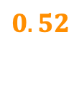
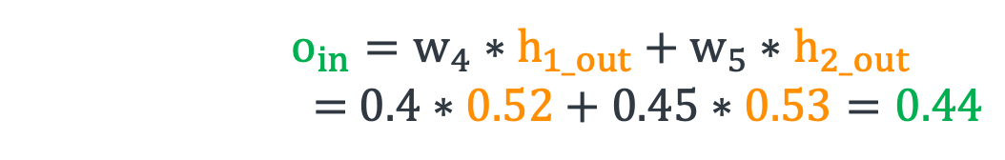
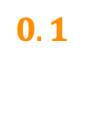
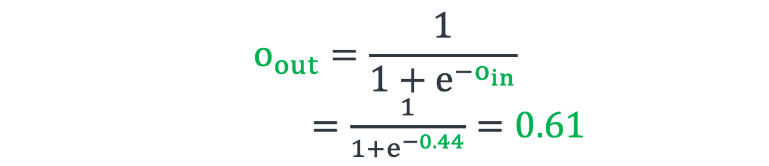
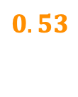
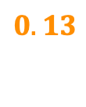
Forward Pass
If w₁ = 0.15, w₂ = 0.25, w₃ = 0.2, w₄ = 0.3, w₅ = 0.4, and w₆ = 0.45:
0.15
$o_{in}=w_{4}∗h_{1_out}+w_{5}∗h_{2_out}$
= $0.4∗0.52+0.45∗0.53=0.44$
0.5
$$0.1$$
$$0.52$$
0.2
0.4
o_{in}
o_{out}
0.25
$$o_{out}=\frac{1}{1+e^{−o_{in}}}$$
$=\frac{1}{1+e^{−0.44}}=0.61$
0.1
0.3
$$0.13$$
$$0.53$$
0.45
For binary classification, we would classify this as class 1 (as 0.61 > 0.5)

Slide 18
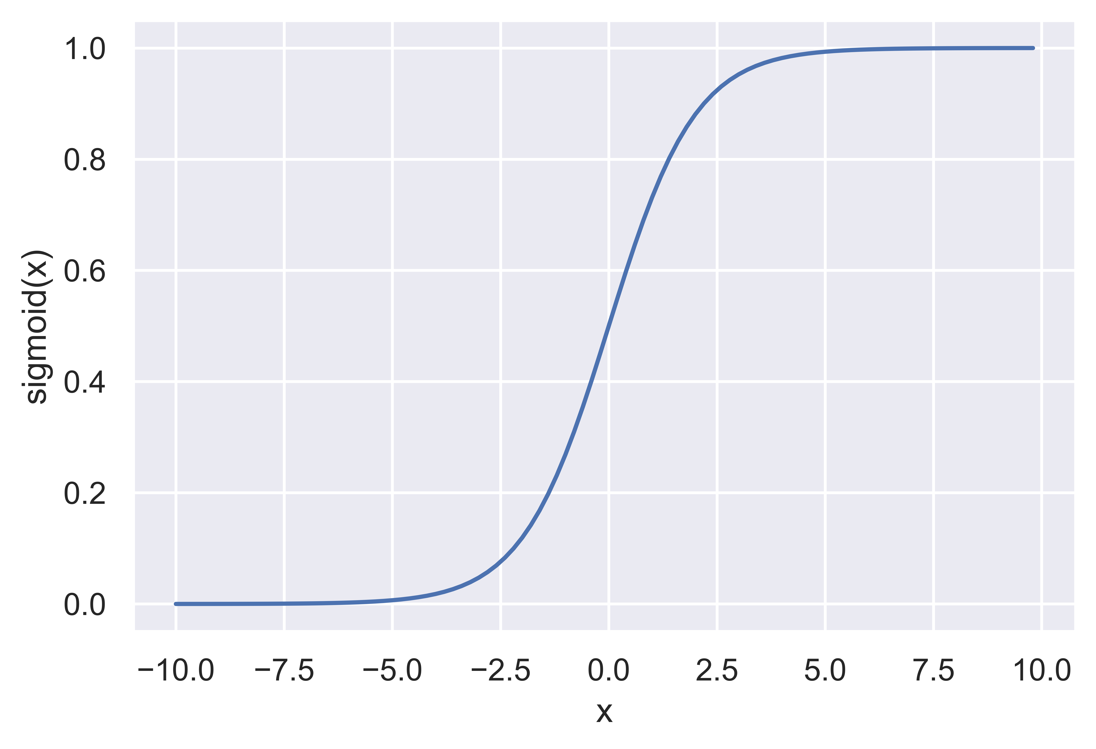
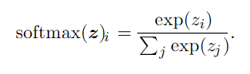
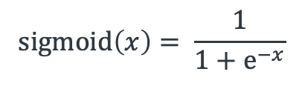
Output Function
$$sigmoid\left(x\right)= \frac{1}{1+e^{−x}}$$
Binary classification: Sigmoid
Outputs P(target class | x) in (0,1)
Logistic Regression of output of last layer
Multi-class classification: Softmax
Still want probability for each class output in (0,1)
Want sum of output to be 1 (probability distribution)
Training drives value for target class up, others down
Regression: Output activation can be linear or ReLU

Slide 19
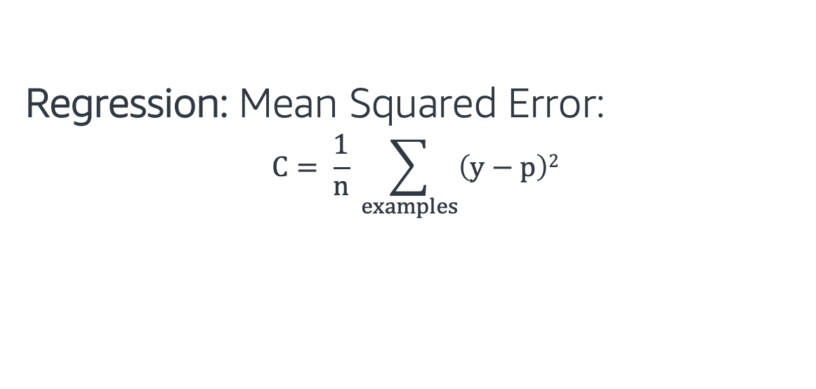
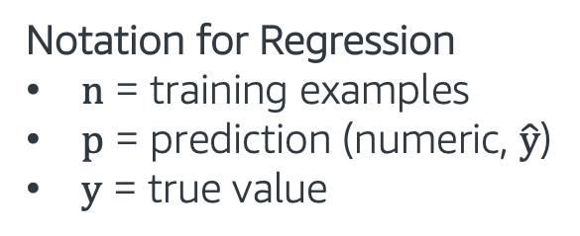
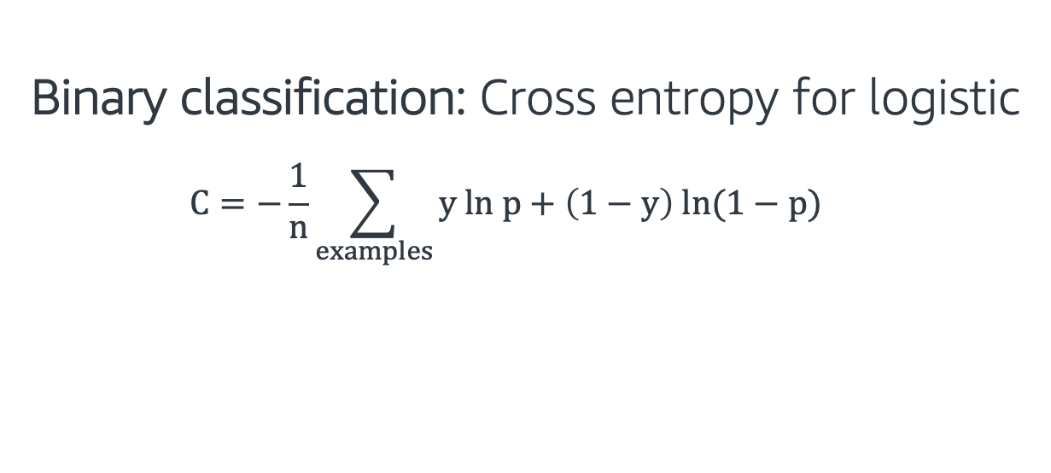
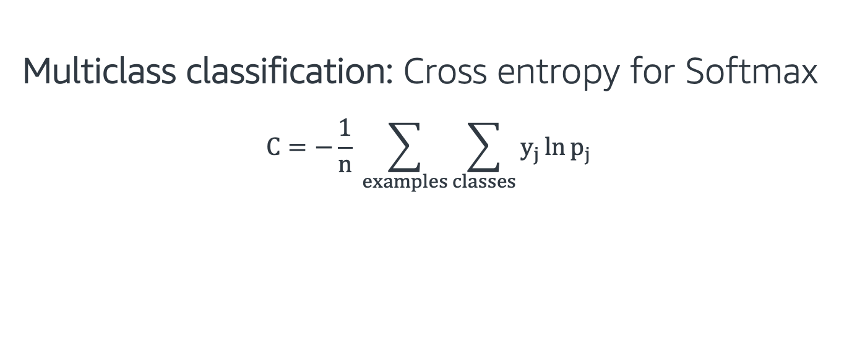
Cost Functions
Binary classification: Cross entropy for logistic
$$C=−\frac{1}{n}\sum_{examples}{y ln p+\left(1−y\right) ln(1−p)}$$
Notation for Classification
n = training examples
j = classes
p = prediction (probability)
y = true class (1/yes, 0/no)
Multiclass classification: Cross entropy for Softmax
$$C=−\frac{1}{n} \sum_{examples}{\sum_{classes}{y_{j}\ln{p_{j}}}}$$
Regression: Mean Squared Error:
$$C= \frac{1}{n} \sum_{examples}{\left(y−p\right)2}$$
Notation for Regression
n = training examples
p = prediction (numeric, $\hat{y}$)
y = true value

Slide 20
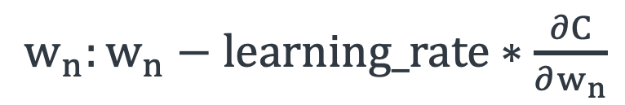
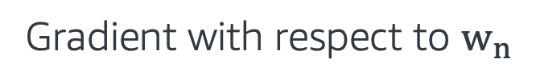
Training Neural Networks
Update the weights by applying the gradient descent method and backpropagation. More details.
Cost function is selected according to problem: Binary, Multi-class Classification or Regression.
Weight update formula:
$w_{n}:w_{n}−learning_rate∗\frac{∂C}{∂w_{n}}$
C: Cost
Gradient with respect to $w_{n}$

Slide 21
Dropout
Regularization technique to prevent overfitting.
Randomly removes some nodes with a fixed probability during the training.
More details.

Slide 22

Neural Networks - Hands on
In this exercise, we implement neural networks using the Gluon Library.
Gluon is an open source deep learning library.
The exercise covers the following topics:
Sequential module
Loss functions
Trainer module
Follow through this notebook: “EMBK-NLP-DAY3-NN-NB.ipynb”

Slide 23
Topics for Day 3
Neural Networks (NN)
Word Embeddings
Recurrent Neural Networks (RNN)
Long Short-Term Memory (LSTM)
Transformers
Final Project

Slide 24
Word Representations
One-hot-encoding: We can represent each word in a vocabulary with one-hot codes.
Example: Assume a vocabulary V of size 10,000
V = [<UNKN>, a, about, …, zombie] (<UNKN> is reserved for unknown words)
Word | Code
<UNKN> | [1, 0, 0, …., 0]
a | [0, 1, 0, …., 0]
about | [0, 0, 1, …., 0]
.. | ..
.. | ..
zombie | [0, 0, 0, …., 1]

Slide 25
Word Representations
Let’s look at the following words and their codes:
man | woman | king | queen | lemon | apple
0 | 0 | 0 | 0 | 0 | 0
0 | 0 | .. | .. | 0 | 1
0 | .. | .. | .. | .. | ..
.. | .. | .. | .. | .. | ..
.. | .. | 1 | .. | .. | ..
.. | .. | .. | .. | 1 | ..
1 | .. | .. | .. | .. | ..
.. | .. | .. | 1 | .. | ..
.. | 1 | .. | .. | .. | ..
.. | .. | .. | .. | .. | ..
One-hot-encoding can’t capture the semantic relationships between words.

Slide 26
Word Representations
Let’s look at the following words and their codes:
man | woman | king | queen | lemon | apple
0 | 0 | 0 | 0 | 0 | 0
0 | 0 | .. | .. | 0 | 1
0 | .. | .. | .. | .. | ..
.. | .. | .. | .. | .. | ..
.. | .. | 1 | .. | .. | ..
.. | .. | .. | .. | 1 | ..
1 | .. | .. | .. | .. | ..
.. | .. | .. | 1 | .. | ..
.. | 1 | .. | .. | .. | ..
.. | .. | .. | .. | .. | ..
One-hot-encoding can’t capture the semantic relationships between words.
What if we were able to assign values to each word?

Slide 27
Word Representations
feature | man | woman | king | queen | lemon | apple
gender | -1 | 1 | -0.9 | 0.9 | 0.1 | 0.2
Let’s start adding features and assign a number for the relationship

Slide 28
Word Representations
feature | man | woman | king | queen | lemon | apple
gender | -1 | 1 | -0.9 | 0.9 | 0.1 | 0.2
royal | 0.05 | 0.2 | 1 | 1 | 0.05 | 0.03
Let’s start adding features and assign a number for the relationship

Slide 29
Word Representations
feature | man | woman | king | queen | lemon | apple
gender | -1 | 1 | -0.9 | 0.9 | 0.1 | 0.2
royal | 0.05 | 0.2 | 1 | 1 | 0.05 | 0.03
food | 0.03 | 0.01 | 0.02 | 0.05 | 1 | 1
Let’s start adding features and assign a number for the relationship

Slide 30
Word Representations
feature | man | woman | king | queen | lemon | apple
gender | -1 | 1 | -0.9 | 0.9 | 0.1 | 0.2
royal | 0.05 | 0.2 | 1 | 1 | 0.05 | 0.03
food | 0.03 | 0.01 | 0.02 | 0.05 | 1 | 1
fruit | 0.01 | 0.03 | 0.02 | 0.04 | 1 | 1
Let’s start adding features and assign a number for the relationship

Slide 31
Word Representations
feature | man | woman | king | queen | lemon | apple
gender | -1 | 1 | -0.9 | 0.9 | 0.1 | 0.2
royal | 0.05 | 0.2 | 1 | 1 | 0.05 | 0.03
food | 0.03 | 0.01 | 0.02 | 0.05 | 1 | 1
fruit | 0.01 | 0.03 | 0.02 | 0.04 | 1 | 1
.. | .. | .. | .. | .. | .. | ..
.. | .. | .. | .. | .. | .. | ..
.. | .. | .. | .. | .. | .. | ..
Let’s start adding features and assign a number for the relationship
We will call these set of numbers: “Word Vectors”

Slide 32
Word2Vec
Word2Vec is a two layer neural network that produces word vectors also called “word embeddings”.
This model produces similar vectors for semantically similar words.
Text Corpus
Embedding Matrix
Intuition, curiosity, and the power of wandering
From very early on in Amazon’s life, we knew we wanted to create a culture of builders – people who are curious, explorers. They like to invent. Even when they’re experts, they are “fresh” with a beginner’s mind. They see the way we do things as just the way we do things now. A builder’s mentality helps us approach big, hard-to-solve opportunities with a humble conviction that success can come through iteration: invent, launch, reinvent, relaunch, start over, rinse, repeat, again and again. They know the path to success is anything but straight.
Sometimes (often actually) in business, you do know where you’re going……….
 | D-dimensional vector
ad
amazon
…
…
….
zoom
Word2Vec

Slide 33
Skip-gram Model
Skip-gram model tries to predict the context words given a center word.
Echo is a smart-speaker developed by Amazon
context
center
context
Echo is a smart-speaker developed by Amazon
W_{t-3}
W_{t-2}
W_{t-1}
W_{t}
W_{t+1}
W_{t+2}
W_{t+3}

Slide 34
Skip-gram Model
Echo is a smart-speaker developed by Amazon
W_{t-3}
W_{t-2}
W_{t-1}
W_{t}
W_{t+1}
W_{t+2}
W_{t+3}
Skip-gram model tries to predict the context words given a center word.
More details.

Slide 35
Continuous Bag of Words (CBOW)
Echo is a smart-speaker developed by Amazon
W_{t-3}
W_{t-2}
W_{t-1}
W_{t}
W_{t+1}
W_{t+2}
W_{t+3}
Skip-gram model tries to predict the center word given context words.
More details.

Slide 36
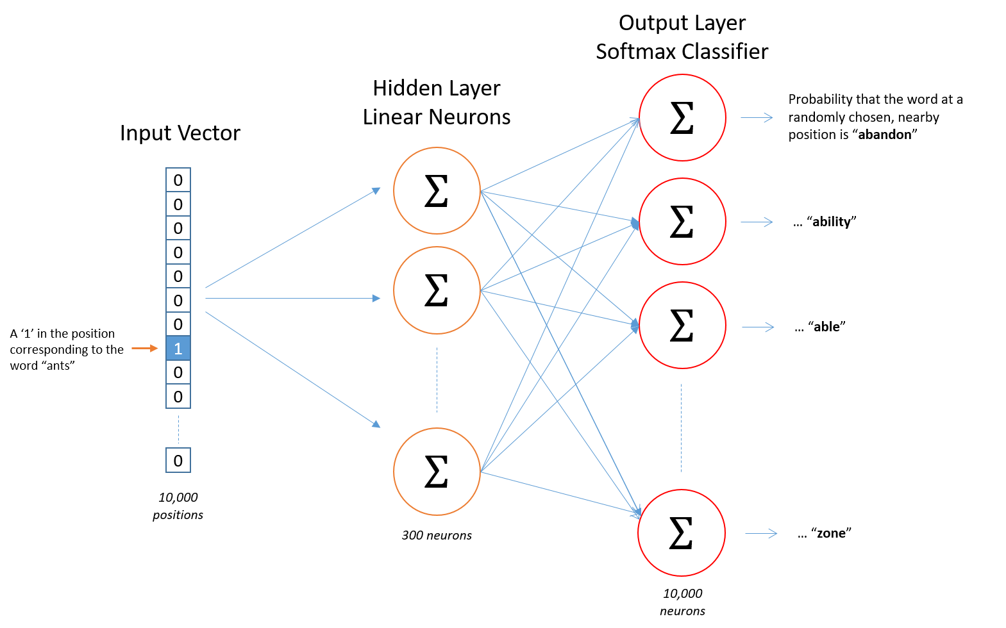
Word2Vec (Skip-gram)
The network learns 300 features for each word.
Sample corpus size is 10,000 words.
Output size and one-hot encoding size matches the corpus size (10,000).

Slide 37
Some other Word Embeddings
Shallow:
GloVe: Improved upon word2vec. It also considers statistical word co-occurance. More details.
ConceptNet-Numberbatch: Combines data from word2vec, Glove and ConceptNet. More details.
fastText: Considers fixed length sequence of characters (n_gram) instead of words. More details.
Deep:
BERT: Considers fixed length sequence of characters (n_gram) instead of words.

Slide 38
Word Vectors - Hands on
In this exercise, we work with Word Vectors from ConceptNet Numberbatch.
The exercise covers the following topics:
Read the word vectors from their source
Understand word similarity
Reduce vectors dimensions and visualize them
Follow through this notebook: “EMBK-NLP-DAY3-WORD-VECS-NB.ipynb”

Slide 39
Topics for Day 3
Neural Networks (NN)
Word Embeddings
Recurrent Neural Networks (RNN)
Long Short-Term Memory (LSTM)
Transformers
Final Project

Slide 40
Recurrent Neural Networks
Recurrent Neural Network (RNN)
A special neural network architecture that can use internal state to process sequences of inputs (time series, text sequences, etc.)
It can preserve the sequential information between elements in the same sequences
Text data involves sequential information of words. Therefore, after words are converted to word vectors, we can use them with RNNs.

Slide 41
Sample RNN
X: inputs
H: states
t: timestamp

Slide 42
The Vanilla RNN Cell
W_{hx}: Input weight matrix
W_{hh}: State weight matrix
W_{ho}: Output weight matrix
Hidden state update:
Observation update:

Slide 43
RNN Cells
W_{hx}: Input weight matrix
W_{hh}: State weight matrix
W_{ho}: Output weight matrix
Weight sharing: Each unit has the same weights:
W_{hx}, W_{hh}, W_{ho}

Slide 44
Stacking RNNs
We can increase the complexity of the model by stacking RNNs and increasing the depth of the model.

Slide 45
Putting it all together - Hands on
In this exercise, we continue to work with our final project dataset (but predicting a different field, log_votes).
The exercise covers the following topics we learned today:
GloVe Word Vectors
ML Model: Recurrent Neural Network (RNN)
Follow through this notebook: “EMBK-NLP-DAY3-RNN-NB.ipynb”

Slide 46
Topics for Day 3
Neural Networks (NN)
Word Embeddings
Recurrent Neural Networks (RNN)
Long Short-Term Memory (LSTM)
Transformers
Final Project

Slide 47
Long Short-Term Memory (LSTM)
RNNs may have difficulty with long-term dependency in input sequences.
Long Short-Term Memory (LSTM) networks are special RNNs, which solve the problem by employing different gate and memory cells:
Gates:
Input gate
Forget gate
Output gate
Memory cells:
Candidate memory cell
Memory cell
Hidden state

Slide 48
Long Short-Term Memory (LSTM)

Slide 49
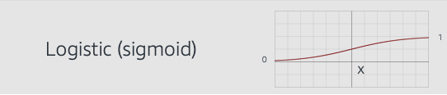
Forget Gate
Forget gate decides how much information to be forgotten.
X_{t} and H_{t-1} are multiplied by a weight matrix.
Sigmoid is applied to this multiplication.

Slide 50
Input Gate
Input gate decides how much new (useful) information to be added.
X_{t} and H_{t-1} are multiplied by a weight matrix.
Sigmoid is applied to this multiplication.

Slide 51
Output Gate
Output gate decides how much information to be outputted.
X_{t} and H_{t-1} are multiplied by a weight matrix.
Sigmoid is applied to this multiplication.

Slide 52
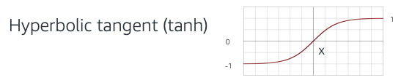
Candidate Memory Cell
Processes new information.
Will be passed through the input gate.
X_{t} and H_{t-1} are multiplied by a weight matrix.
Tanh is applied to this multiplication.

Slide 53
Memory Cell
Memory cell sums up:
“Forget gate” applies on the previous memory cell
“Input gate” applies on the candidate memory cell

Slide 54
Hidden State
“Output gate” applies on current memory cell.
Will be passed to the next LSTM.

Slide 55
Long Short-Term Memory (LSTM)

Slide 56
Topics for Day 3
Neural Networks (NN)
Word Embeddings
Recurrent Neural Networks (RNN)
Long Short-Term Memory (LSTM)
Transformers
Final Project

Slide 57
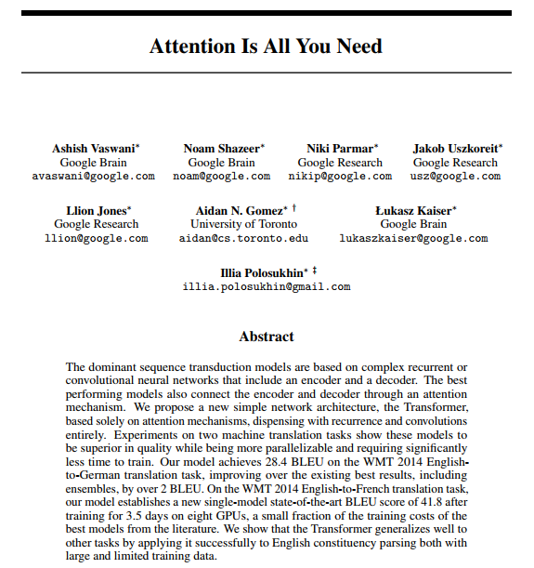
What are Transformers
Transformers are a type of neural network architecture that builds high level representations of text directly allowing for long range correlations, rather than building it sequentially.
A series of landmark papers starting with “Attention is all you need” have established it as the state-of-the-art technique for most NLP tasks.

Slide 58
An Alternate View
Recurrent Neural networks process one token at a time
In linguistics, people believe that instead sentences are best understood by combining into higher level concepts
Can we make a model that mirrors this philosophy?
I
kicked
the
ball
S
VP
S: Sentence
VP: Verb Phrase
NP: Noun Phrase
NP
NP
I
kicked
the
ball

Slide 59
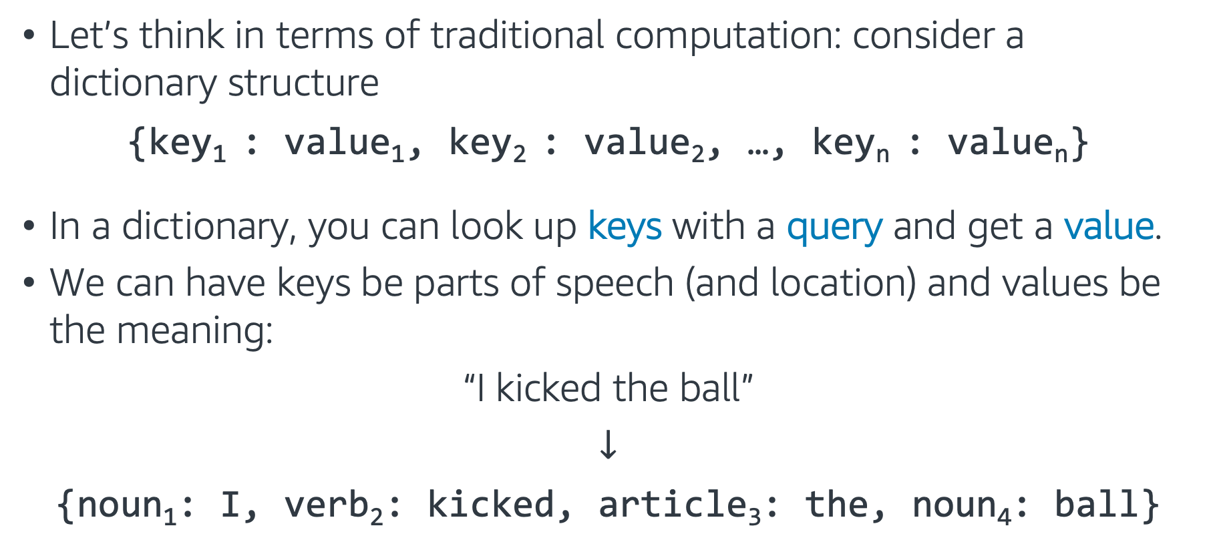
Traditional Programming Intuition 1
Let’s think in terms of traditional computation: consider a dictionary structure
{key₁ : value₁, key₂ : value₂, …, key_{n} : value_{n}}
In a dictionary, you can look up keys with a query and get a value.
We can have keys be parts of speech (and location) and values be the meaning:
“I kicked the ball”
$↓$
{noun₁: I, verb₂: kicked, article₃: the, noun₄: ball}

Slide 60
Traditional Programming Intuition 2
To build trees like we saw, each token can query for other nearby tokens that match a target:
Each noun queries for a nearby verb to be the subject or object of
Articles query for nearby nouns
Verbs query for objects
and so on…
{noun₁: I, verb₂: kicked, article₃: the, noun₄: ball}
Verb?
Noun?
Noun?
Verb?

Slide 61
Traditional Programming Intuition 3
These can then be combined into higher level objects.
This can be iterated until the entire sentence merges.
{NP₁: I kicked, VP₂: kicked ball, NP₃: the ball, VP₄: kicked ball}
{noun₁: I, verb₂: kicked, article₃: the, noun₄: ball}

Slide 62
What does this require?
For this process to work we needed a few components:
A key describing what questions each word responded to
A value describing what information that word contains when it answers a question
A query describing what every word was looking to combine with
Then the values were combined for those keys that matched the queries, and the process repeated.

Slide 63
How to Build as a Neural Network
As common in neural architectures, the key, query, and value will all be represented by vectors of numbers.
Query
Word & Position
Average
Vector
Key
Softmax
Vector
Value
Query
Word & Position
Average
Vector
Key
Softmax
Vector
Value

Slide 64
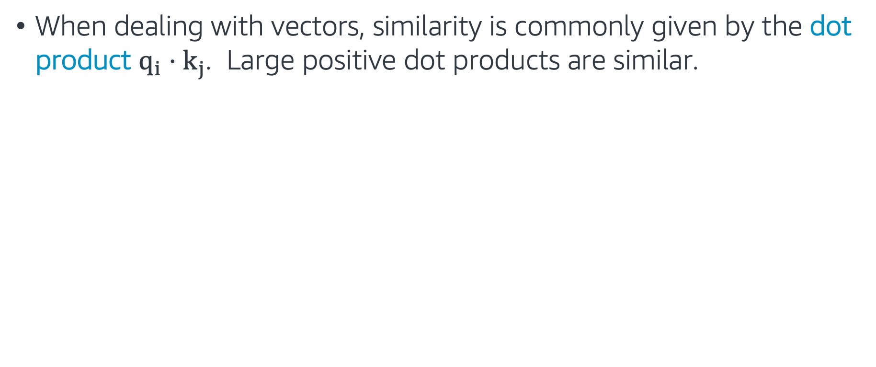
How to Build as a Neural Network
When dealing with vectors, similarity is commonly given by the dot product $q_{i}⋅k_{j}$. Large positive dot products are similar.
Dot products
Query
Word & Position
Average
Vector
Key
Softmax
Vector
Value
Query
Word & Position
Average
Vector
Key
Softmax
Vector
Value

Slide 65
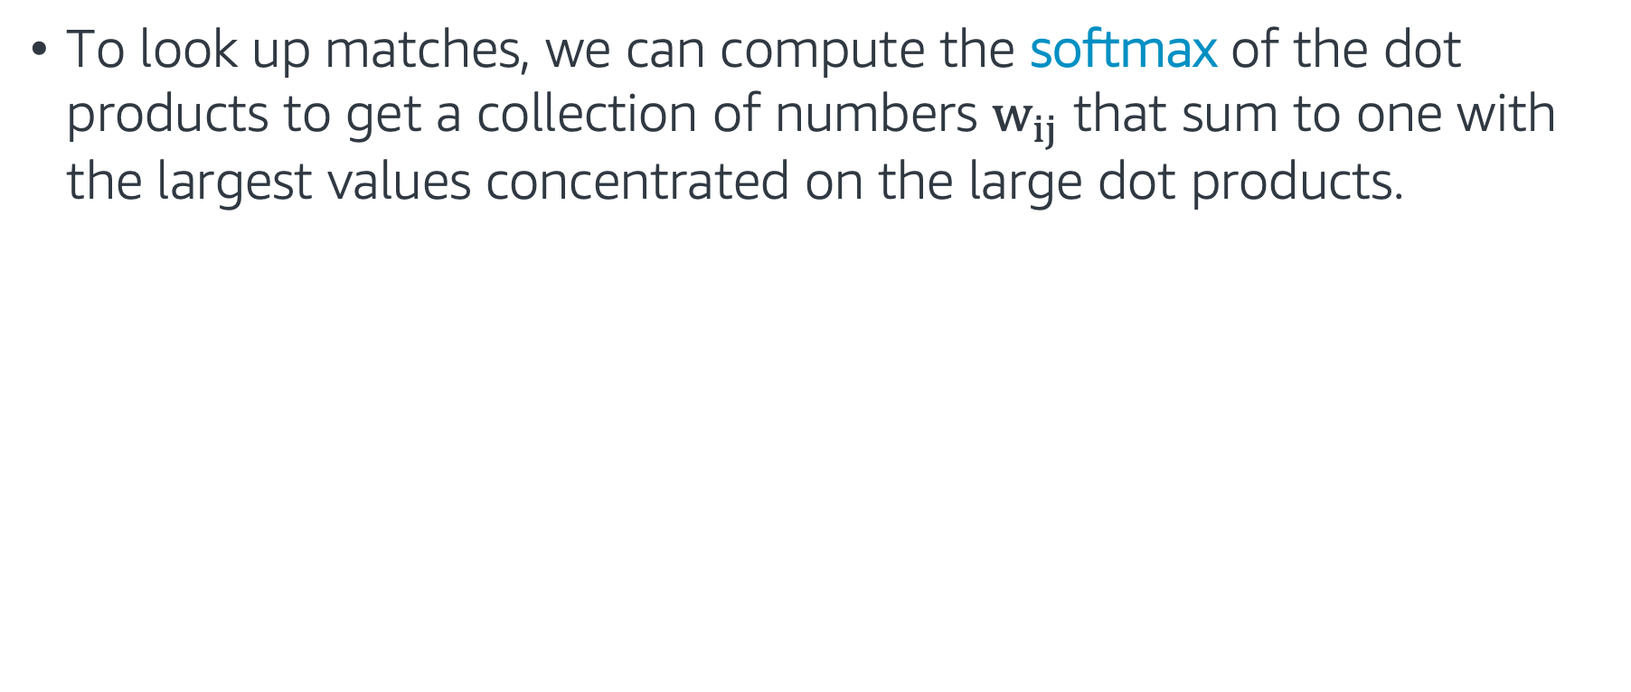
How to Build as a Neural Network
To look up matches, we can compute the softmax of the dot products to get a collection of numbers $w_{ij}$ that sum to one with the largest values concentrated on the large dot products.
Dot products
Query
Word & Position
Average
Vector
Key
Softmax
Vector
Value
Query
Word & Position
Average
Vector
Key
Softmax
Vector
Value

Slide 66
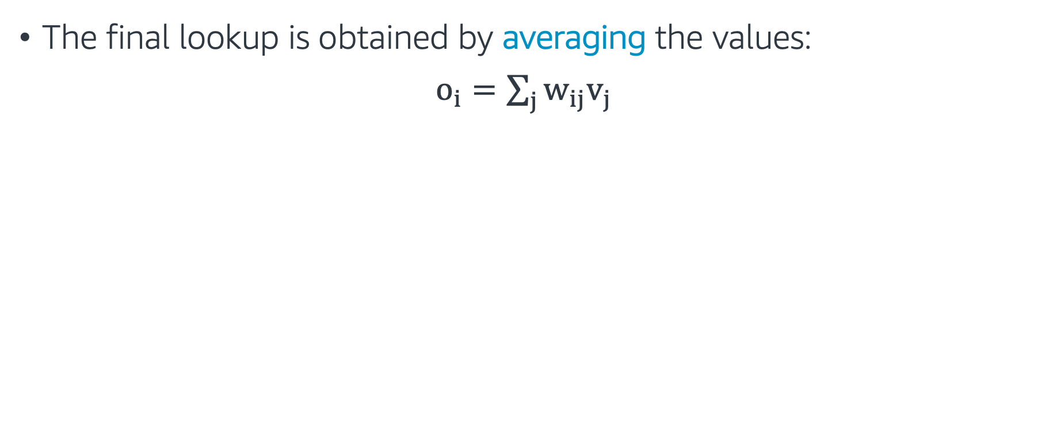
How to Build as a Neural Network
The final lookup is obtained by averaging the values:
$o_{i}=\sum_{j}{w_{ij}v_{j}}$
Dot products
Query
Word & Position
Average
Vector
Key
Softmax
Vector
Value
Query
Word & Position
Average
Vector
Key
Softmax
Vector
Value

Slide 67
How to Build as a Neural Network
This process is repeated for every location in the network.
Dot products
Query
Word & Position
Average
Vector
Key
Softmax
Vector
Value
Query
Word & Position
Average
Vector
Key
Softmax
Vector
Value

Slide 68
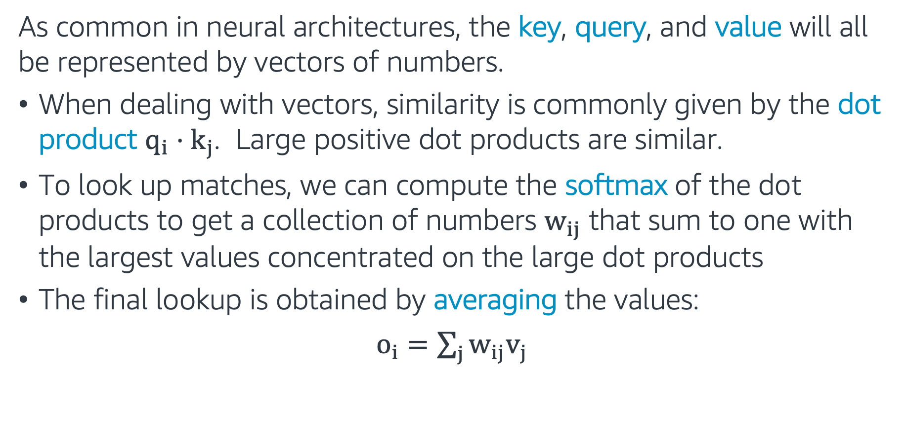
In summary
As common in neural architectures, the key, query, and value will all be represented by vectors of numbers.
When dealing with vectors, similarity is commonly given by the dot product $q_{i}⋅k_{j}$. Large positive dot products are similar.
To look up matches, we can compute the softmax of the dot products to get a collection of numbers $w_{ij}$ that sum to one with the largest values concentrated on the large dot products
The final lookup is obtained by averaging the values:
$o_{i}=\sum_{j}{w_{ij}v_{j}}$

Slide 69
Attention
Attention is a mechanism that forces the model to learn to focus (to attend) on specific parts of the input sequence.
Self-Attention is a mechanism where every token in the data attends to all other tokens in the input sequence.

Slide 70
An issue: Polysemy
Consider some of the meanings of the word ”tie”
How do we adapt our model to allow for this ambiguity?
verb: to fasten or attach
“I tied the bag closed.”
verb: to establish in relationship
“We tied the criminal to the scene of the crime.”
noun: railway supports
“She hammered the rail to the tie.”
noun: sustained tone in music:
“The tie holds the note into the next measure.”
noun: equality in a contest
“The game ended in a tie.”
noun: Something knotted when worn
“He put on his favorite tie for the job interview”

Slide 71
Multi-headed Attention
To solve this issue, every token (and every subsequent layer) will emit multiple keys, multiple values, and multiple queries! This is called multi-headed attention.
Query
Word & Position
Query
Query
Softmax
Average
Vector
Key
Softmax
Average
Key
Softmax
Average
Vector
Key
Value
Value
Value
Query
Word & Position
Query
Query
Softmax
Average
Vector
Key
Softmax
Average
Key
Softmax
Average
Vector
Key
Value
Value
Value

Slide 72
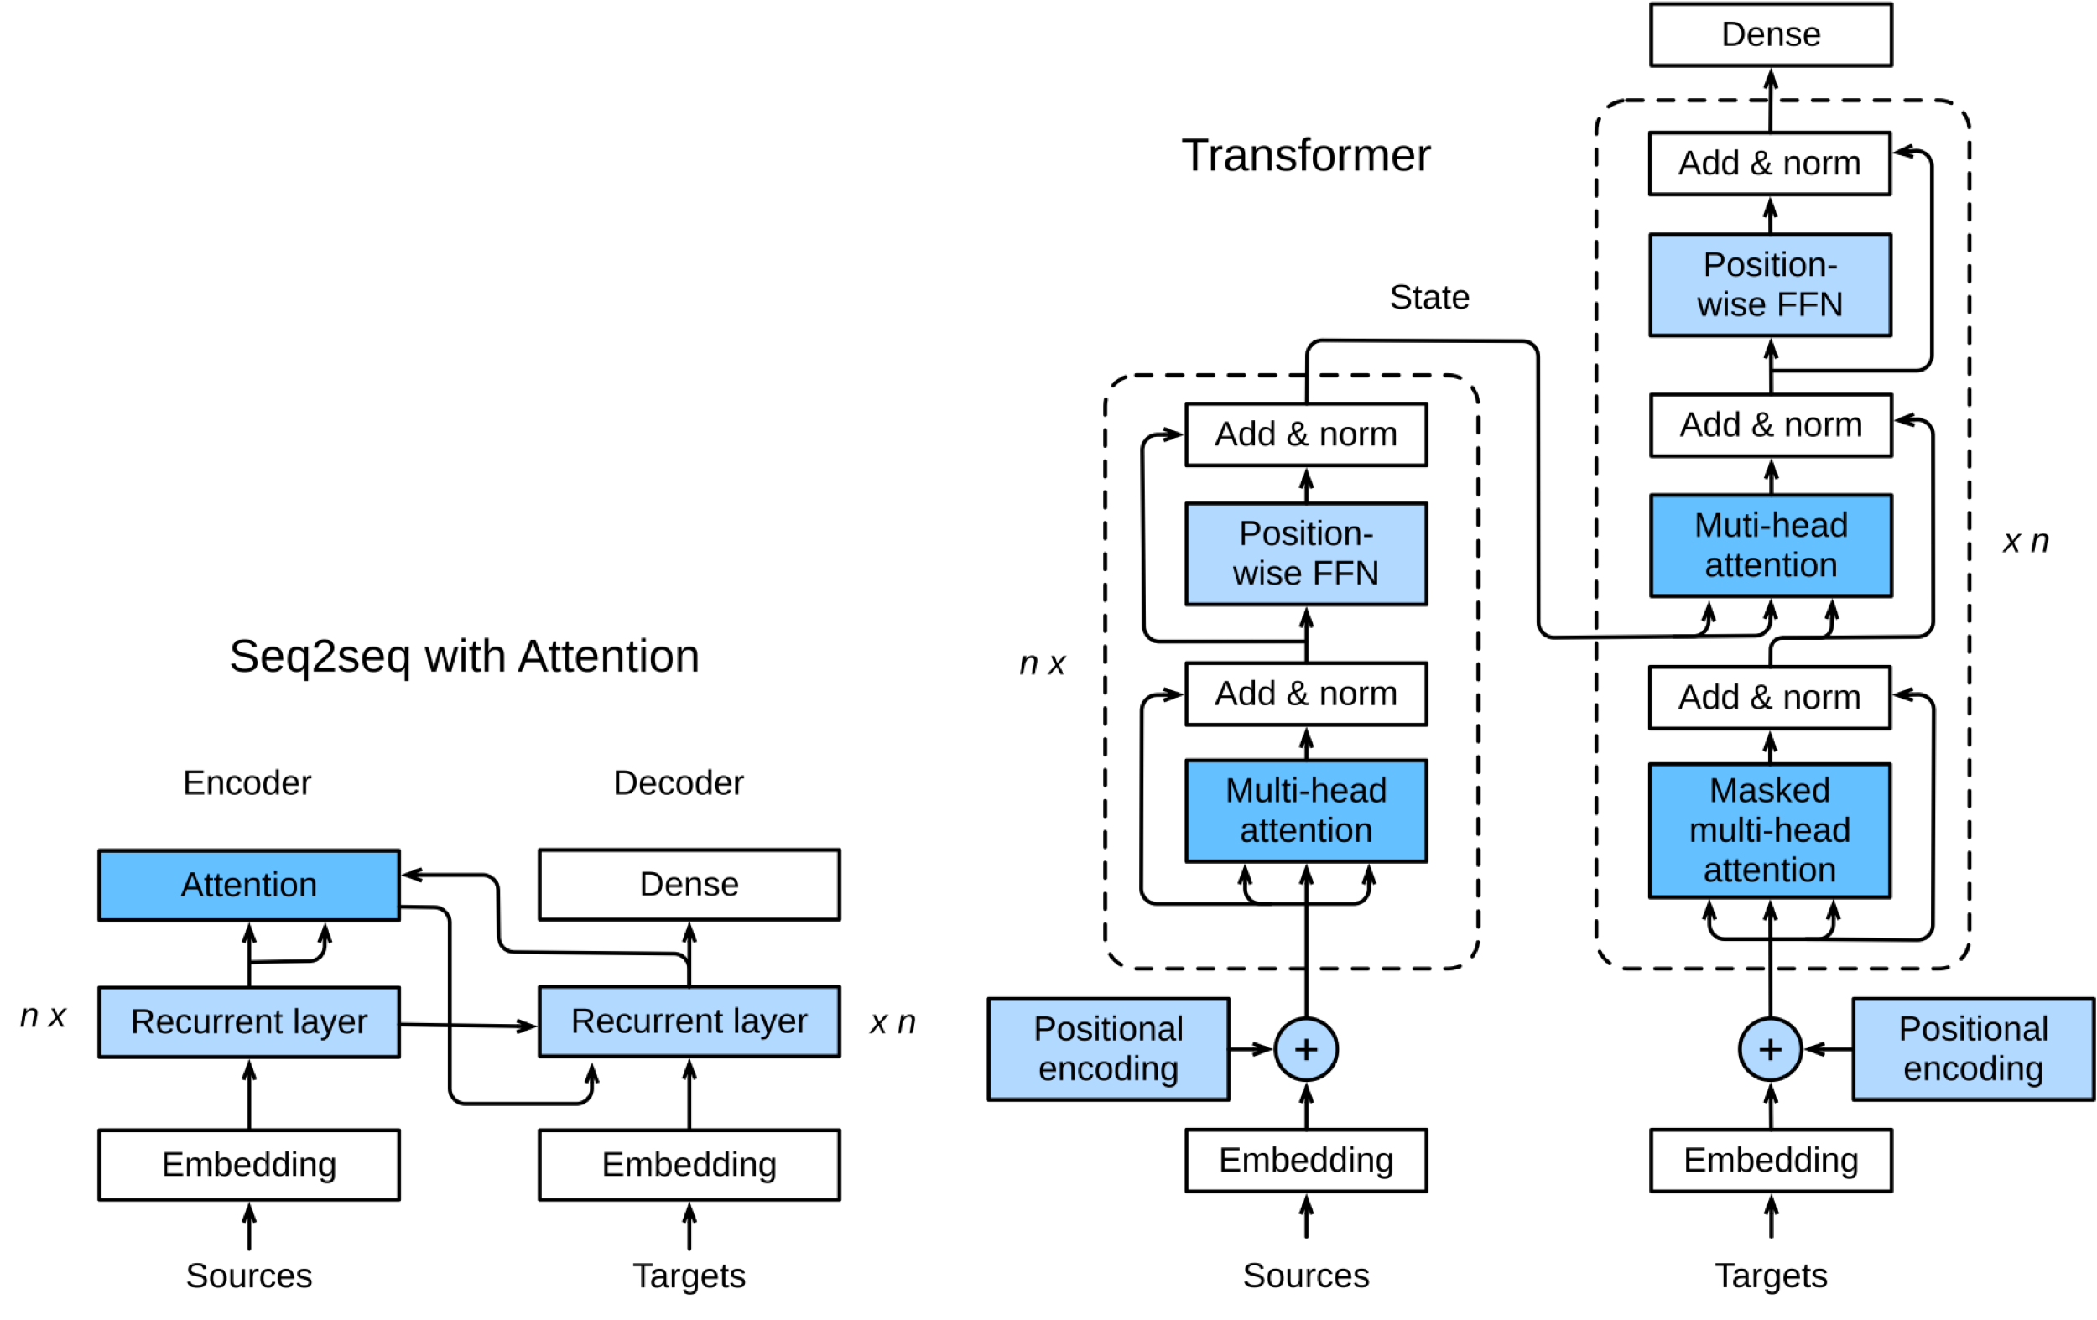

Transformers
The full transformer architecture is made by combining many layers of this type, often times into an encoder-decoder pair which turns words into vectors then vectors back to words.
Full details are available at d2l.ai.

Slide 73
Pre-trained Models
These models tend to be very large, and can take weeks to train on the most expensive instances. Thus, is common to pre-train a model on a large corpus of text, and use it for downstream tasks.
The Gluon NLP Model Zoo contains a large number of pretrained transformers (in this case versions of BERT, one of the original largescale transformers).

Slide 74
Utilizing Pre-trained Models
There are multiple ways to use these pre-trained models:
Use it as a fixed encoder (no training cost). We investigate this in a notebook example.
The model can be fine-tuned end-to-end as a classifier.
The model can be fine-tuned as a language model on your specific dataset, then used as an encoder or fine-tuned on the classification task.
The model can be trained from scratch. This is very intensive, and should only be done with 50GB+ of text.
INCREASING COST

Slide 75
Transformers - Hands on
In this exercise, we work with BERT from Gluon NLP Model Zoo
The exercise covers the following topics:
Installing Gluon NLP
Using a pretrained BERT model to encode a sentence
Follow through this notebook: “EMBK-NLP-DAY3-BERT-NB.ipynb”

Slide 76
NLP Roadmap

Slide 77
Topics for Day 3
Neural Networks (NN)
Word Embeddings
Recurrent Neural Networks (RNN)
Long Short-Term Memory (LSTM)
Transformers
Final Project

Slide 78
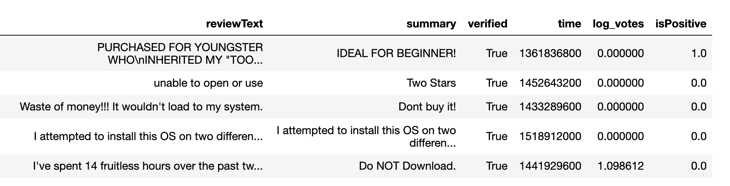
Final Project – Sentiment Analysis
Data: Customer reviews. Let's look at first 5 rows of the training dataset:
Task: Train a classifier to predict the isPositive field for the test dataset.
Follow through this notebook ”EMBK-NLP-DAY3-FINAL-STUDENT-NB.ipynb” to start on the final project.

Slide 79
Notebooks for Day 3
EMBK-NLP-DAY3-NN-NB.ipynb: Build Neural Networks with Gluon
EMBK-NLP-DAY3-WORD-VECS-NB.ipynb: Word Vectors
EMBK-NLP-DAY3-RNN-NB.ipynb: Train Recurrent Neural Networks
EMBK-NLP-DAY3-BERT-NB.ipynb: Gluon NLP and BERT
EMBK-NLP-DAY3-FINAL-STUDENT-NB.ipynb: Final Project Walkthrough for Day 3
EMBK-NLP-DAY3-FINAL-SOLUTION-NB.ipynb: Final Project Solution for Day 3

Slide 80
Looking Ahead - Day 4
Tabular Data
AutoML
Computer Vision Applications
Images and Filtering
Convolutional Neural Networks (CNN)
Transfer Learning

